Slide 1
Capstone Project
Analysing and Predicting the Earning Potential of Adults
Name : Nand nandan sharma (0788539)
Shubham chopra (0782220)
Institution Name : St.Clair College
Submitted to : Ms. Savita Sherawat

Slide 2
Abstract
Income plays a significant role in determining a person's level of living and financial standing in society. It is crucial in deciding the nation's growth or "A huge income is the best prescription for happiness I ever heard of," Jane Austen reportedly said. It is crucial in deciding the nation's growth. Our goal is to find relevant insights that may be used to make better decisions. Figures for 32561 separate records and 15 attributes for 42 countries are included in the data collection. The weights on the CPS files (Current Population Survey) are based on independent estimates of the civilian non-institutional population in the United States. The Census Bureau's Population Division prepares them for us on a monthly basis. The income level is the binomial label in the data set, and it predicts whether a person makes more than $50,000 per year based on a given set of attributes.

Slide 3
Research Questions
Predict adult(s) education who are most likely to earn more than 50k$ income?
Visualize the median age of people who earn more than 50k$ income and less than 50k$?
Which gender is likely to have maximum count to earn more than 50k$?
Build different classification models to validate our findings. The model includes logistic regression, Naïve Bayes classifier, KNN, Random Forest classifier.

Slide 4
Data Preprocessing

Slide 5
Data Preprocessing
Detailed Data Dictionary
Cleaning the data
Missing Values
The dataset contains a number of missing values for categorical categories, such as work class, occupation, and native country, which have been addressed via algorithmic transformations. For each attribute, the missing values are handled in a flexible manner by providing a default marker called ‘?’ and designating a unique category for avoiding information loss. The dataset contains special character ‘?’ which we handled by replacing it with NA’s.
workclass | Count of Missing values
occupation | 1843
workclass | 1836
Country | 582

Slide 6
Exploratory Data Analysis(EDA)

Slide 7
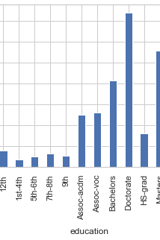
Predict adult(s) education who are most likely to earn more than 50k$ income?
Adults with a Prof-school and Doctorate educational background will have a greater salary, and it is likely that they will earn more over $50,000.

Slide 8
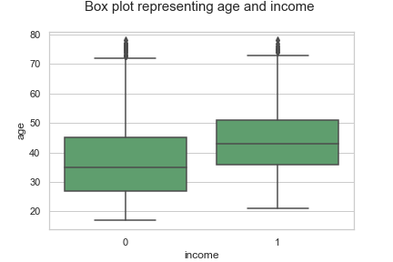
Visualize the median age of people who earn more than 50k $ income and less than 50k $?
As can be seen, persons earning less than $50,000 have a median age of around 34 years, while those earning more than $50,000 have a median age of around 45 years.

Slide 9
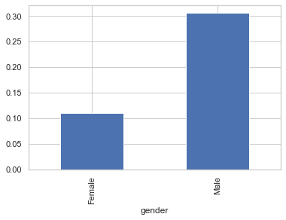
Which gender is likely to have maximum count to earn more than 50k$?
The gender bar chart shows that men are more likely to have a greater salary than women.

Slide 10
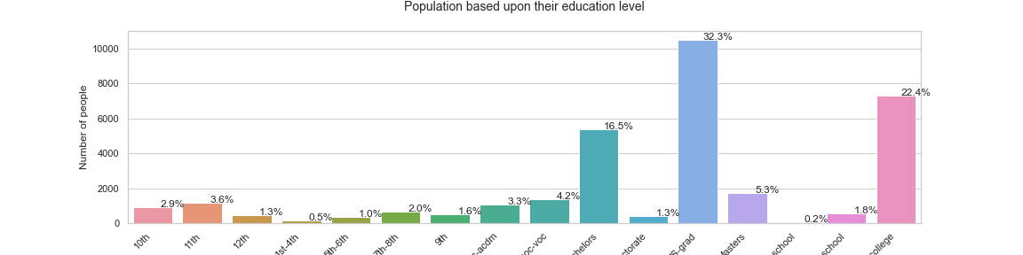
Population based upon their education level
The bargraph illustrates that the majority participants in the dataset are High School Graduates, followed by some college, then Bachelors degree holders.

Slide 11
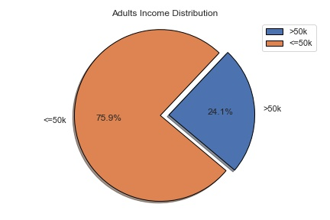
Distribution of the target variable
The pie shows that 24.1% individuals have >50k income whereas 75.9% corresponds to <=50k income.

Slide 12
Variance of the variables:
Attributes | Description
age | 1.45E+02
fnlwgt | 7.58E+09
EducationNum | 5.00E+00
CapitalGain | 0.00E+00
CapitalLoss | 0.00E+00
HoursPerWeek | 1.60E+01
income | 0.00E+00
I remove the attributes Capital Gain and Capital Loss from the data set that have almost zero variance because they don't provide any information about the dataset.

Slide 13
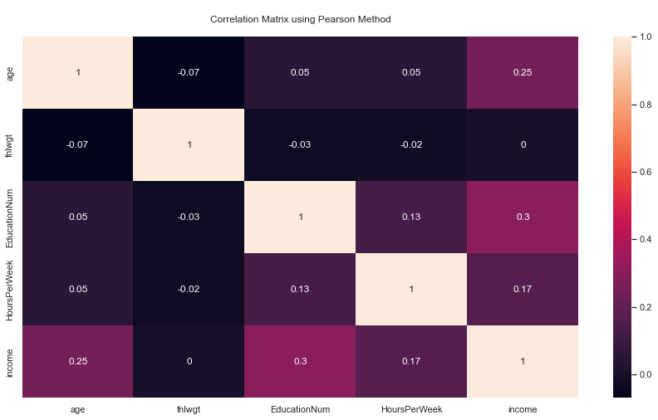
Correlation
The correlation graphs explain how one variable influences the other by depicting the link between two variables in two different ways. The value might be anywhere between -1 and 1. None of the variables have a substantial relationship.

Slide 14
Correlation between target variable and the other Attribute
Attribute Names | income
income | 1
EducationNum | 0.295074
age | 0.245649
HoursPerWeek | 0.172764
fnlwgt | 0.000373

Slide 15
Normalize the data sets:
Rescaling real-valued numeric attributes into a 0 to 1 range is referred to as normalisation.
Normalization is the process of changing data into a normal form, which entails using a mathematical approach to achieve the balance in the data. It is the process of converting several types of data into a comparable scale. y = (y - min_value) / (max_value - min_value)
Min-Max Scaling:
Scale each feature to a specific range to transform it. This estimator scales and translates each feature independently so that it falls inside the training set's given range, such as zero to one.

Slide 16
Experimental Design

Slide 17
Train and Test Split Approach:
In this strategy, the whole informational collection is divided into training and test sets. I separated the data into two sections (training and test sets). The Training set contains 70% of the records in the informational collection, though the Test set contains 30% of the data.

Slide 18
Treatment for imbalance:
SMOTE (synthetic minority oversampling technique)
SMOTE (Synthetic Minority Oversampling Strategy) is a statistical technique for evenly increasing the number of cases in your dataset. The component generates new instances based on existing minority situations you provide as input.
It's one of the most popular oversampling methods for dealing with the imbalance problem. Its purpose is to achieve a more evenly distributed distribution of classes by randomly replicating minority class cases.

Slide 19
The end
Thank you

